Slide 1

Management
Fourteenth Edition
Chapter 16
Motivating Employees
Copyright © 2018, 2016, 2014 Pearson Education, Inc. All Rights Reserved

Slide 2
Learning Objectives
16.1 Define motivation.
16.2 Compare and contrast early theories of motivation.
16.3 Compare and contrast contemporary theories of motivation.
Develop your skills at motivating employees.
16.4 Discuss current issues in motivation.
Know how to identify what motivates you.

Slide 3
What is Motivation?
Many people incorrectly view motivation as a personal trait; that is, they think some people are motivated and others aren’t.
Motivation: the process by which a person’s efforts are energized, directed, and sustained toward attaining a goal.
Motivating high levels of employee performance is an important organizational concern,
For instance, a Gallup Poll found a large majority of U.S. employees—some 68 percent—are disengaged.
globally : 87 percent employees are not excited about their work.
Notes:
Motivation refers to the process by which a person’s efforts are energized, directed, and sustained toward attaining a goal. This definition has three key elements: energy, direction, and persistence.
The energy element is a measure of intensity, drive, and vigor. A motivated person puts forth effort and works hard. However, the quality of the effort must be considered as well as its intensity. High levels of effort don’t necessarily lead to favorable job performance unless the effort is channeled in a direction that benefits the organization. Effort directed toward and consistent with organizational goals is the kind of effort we want from employees. Finally, motivation includes a persistence dimension. We want employees to persist in putting forth effort to achieve those goals.

Slide 4
EARLY theories of motivation
Four early motivation theories:
Maslow’s hierarchy of needs,
McGregor’s Theories X and Y,
Herzberg’s two-factor theory,
and McClelland’s three-needs theory.

Slide 5
Maslow’s Hierarchy of Needs Theory
Hierarchy of needs theory: Maslow’s theory that human needs—physiological, safety, social, esteem, and self-actualization—form a sort of hierarchy
Notes:
The best-known theory of motivation is probably Abraham Maslow’s hierarchy of needs theory. Maslow was a psychologist who proposed that within every person is a hierarchy of five needs.
Maslow argued that each level in the needs hierarchy must be substantially satisfied before the next need becomes dominant. An individual moves up the needs hierarchy from one level to the next.

Slide 6
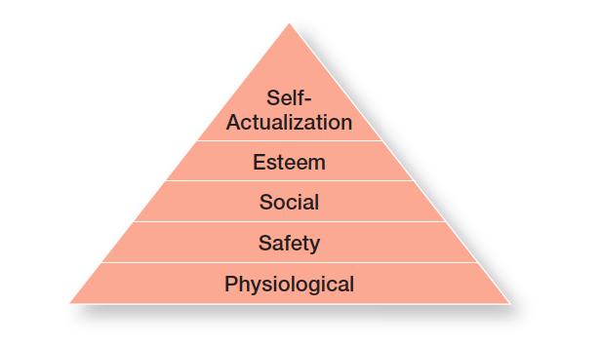
Exhibit 16-1 Maslow’s Hierarchy of Needs
Exhibit 16-1 shows the five levels of need in Maslow’s hierarchy.
Notes:
Source: A. H. Maslow, R. D. Frager, and J. Fadiman, Motivation and Personality, 3rd Edition, © 1987. Reprinted and electronically reproduced by permission of Pearson Education, Inc., Upper Saddle River, NJ.

Slide 7
Levels of Needs (1 of 2)
Physiological needs: a person’s needs for food, drink, shelter, sexual satisfaction, and other physical needs
Safety needs: a person’s needs for security and protection from physical and emotional harm
Social needs: a person’s needs for affection, belongingness, acceptance, and friendship
Notes:
1. Physiological needs: A person’s needs for food, drink, shelter, sex, and other physical requirements.
2. Safety needs: A person’s needs for security and protection from physical and emotional harm as well as assurance that physical needs will continue to be met.
3. Social needs: A person’s needs for affection, belongingness, acceptance, and friendship.

Slide 8
Levels of Needs (2 of 2)
Esteem needs: a person’s needs for internal factors such as self-respect, autonomy, and achievement, and external factors such as status, recognition, and attention
Self-actualization needs: a person’s need to become what he or she is capable of becoming
Notes:
4. Esteem needs: A person’s needs for internal esteem factors such as self-respect, autonomy, and achievement and external esteem factors such as status, recognition, and attention.
5. Self-actualization needs: A person’s needs for growth, achieving one’s potential, and self-fulfillment; the drive to become what one is capable of becoming.

Slide 9
McGregor’s Theory X and Theory Y
Theory X: the assumption that employees dislike work, are lazy, avoid responsibility, and must be coerced to perform
Theory Y: the assumption that employees are creative, enjoy work, seek responsibility, and can exercise self-direction
Notes:
Douglas McGregor is best known for proposing two assumptions about human nature: Theory X and Theory Y. Very simply, Theory X is a negative view of people that assumes workers have little ambition, dislike work, want to avoid responsibility, and need to be closely controlled to work effectively. Theory Y is a positive view that assumes employees enjoy work, seek out and accept responsibility, and exercise self-direction. McGregor believed that Theory Y assumptions should guide management practice and proposed that participation in decision-making, responsible and challenging jobs, and good group relations would maximize employee motivation.

Slide 10
Herzberg’s Two Factor Theory
Two factor theory (motivation-hygiene theory): the motivation theory that intrinsic factors are related to job satisfaction and motivation, whereas extrinsic factors are associated with job dissatisfaction
Notes:
Frederick Herzberg’s two-factor theory (also called motivation-hygiene theory) proposes that intrinsic factors are related to job satisfaction, while extrinsic factors are associated with job dissatisfaction.
Herzberg wanted to know when people felt exceptionally good (satisfied) or bad (dissatisfied) about their jobs. (These findings are shown in Exhibit 16-2.) He concluded that the replies people gave when they felt good about their jobs were significantly different from the replies they gave when they felt badly. Certain characteristics were consistently related to job satisfaction (factors on the left side of the exhibit), and others to job dissatisfaction (factors on the right side).

Slide 11
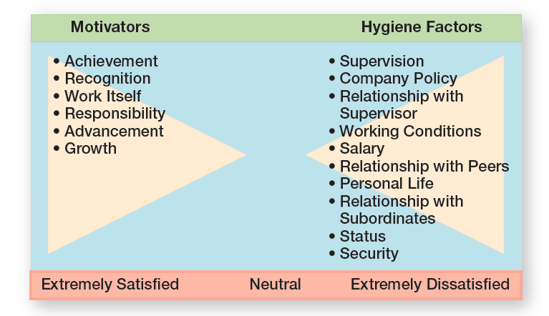
Exhibit 16-2 Herzberg’s Two-Factor Theory
Exhibit 16-2 shows Herzberg’s findings.
Notes:
Source: Based on F. Herzberg, B. Mausner, and B. B. Snyderman, The Motivation to Work (New York: John Wiley, 1959).

Slide 12
Herzberg’s Two Factors
Hygiene factors: factors that eliminate job dissatisfaction, but don’t motivate
Motivators: factors that increase job satisfaction and motivation
Notes:
The extrinsic factors that create job dissatisfaction were called hygiene factors. When these factors are adequate, people won’t be dissatisfied, but they won’t be satisfied (or motivated) either. To motivate people, Herzberg suggested emphasizing motivators, the intrinsic factors having to do with the job itself.

Slide 13
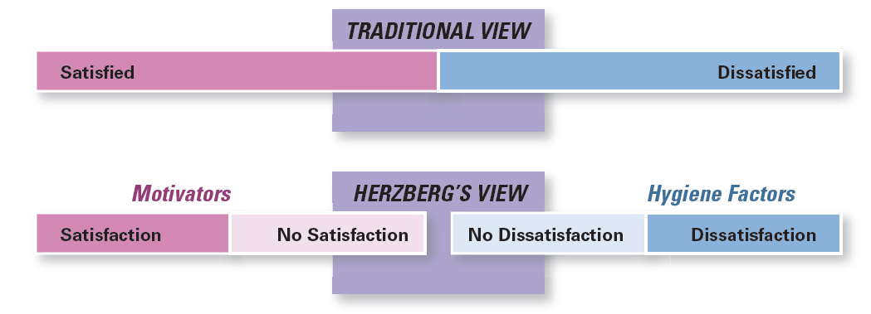
Exhibit 16-3 Contrasting Views of Satisfaction and Dissatisfaction
As shown in Exhibit 16-3, Herzberg proposed that a dual continuum existed: The opposite of “satisfaction” is “no satisfaction,” and the opposite of “dissatisfaction” is “no dissatisfaction.”
Notes:
Herzberg believed the data suggested that the opposite of satisfaction was not dissatisfaction, as traditionally had been believed. Removing dissatisfying characteristics from a job would not necessarily make that job more satisfying (or motivating). As shown in Exhibit 16-3, Herzberg proposed that a dual continuum existed: The opposite of “satisfaction” is “no satisfaction,” and the opposite of “dissatisfaction” is “no dissatisfaction.”

Slide 14
Three-Needs Theory (1 of 2)
Three-needs theory: the motivation theory that says three acquired (not innate) needs— achievement, power, and affiliation—are major motives in work
Need for achievement (nAch): the drive to succeed and excel in relation to a set of standards
Notes:
David McClelland and his associates proposed the three-needs theory, which says three acquired (not innate) needs are major motives in work. These three needs include the need for achievement (nAch), the drive to succeed and excel in relation to a set of standards; the need for power (nPow), the need to make others behave in a way they would not have behaved otherwise; and the need for affiliation (nAff), the desire for friendly and close interpersonal relationships.
People with a high need for achievement are striving for personal achievement rather than for the trappings and rewards of success. They have a desire to do something better or more efficiently than it’s been done before.

Slide 15
Three-Needs Theory (2 of 2)
Need for power (nPow): the need to make others behave in a way that they would not have behaved otherwise
Need for affiliation(nAff): the desire for friendly and close interpersonal relationships
Notes:
The other two needs in this theory haven’t been researched as extensively as the need for achievement. However, we do know that the best managers tend to be high in the need for power and low in the need for affiliation.

Slide 16
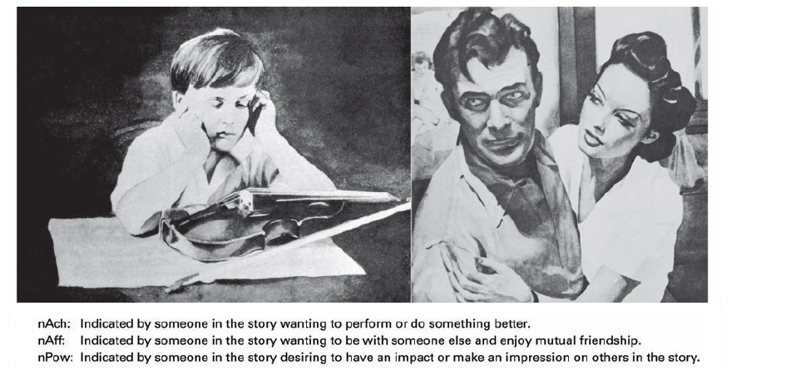
Exhibit 16-4 TAT Pictures
Exhibit 16-4 shows some examples of pictures for the Thematic Apperception Test.
Notes:
All three of these needs can be measured by using a projective test (known as the Thematic Apperception Test or TAT) in which respondents react to a set of pictures. Each picture is briefly shown to a person who writes a story based on the picture. (See Exhibit 16-4 for some examples.) Trained interpreters then determine the individual’s levels of nAch, nPow, and nAff from the stories written.
Photo Source: Bill Aron/PhotoEdit

Slide 17
CONTEMPORARY theories of motivation
These contemporary motivation approaches include
i. goal-setting theory,
Ii. reinforcement theory,
Iii. job design theory,
Iv. equity theory,
V. expectancy theory, and high-involvement work practices

Slide 18
Goal-Setting Theories
goal specificity, challenge, and feedback have an effect on performance. “Just do your best”?
Goal-setting theory: the proposition that specific goals increase performance and that difficult goals, when accepted, result in higher performance than do easy goals.
First, working toward a goal is a major source of job motivation and specific and challenging goals are superior motivating forces.
will employees try harder if they have the opportunity to participate in the setting of goals? Not always
Self-generated feedback—where an employee monitors his or her own progress—has been shown to be a more powerful motivator than feedback coming from someone else
Notes:
Research provides substantial support for goal-setting theory, which says that specific goals increase performance and that difficult goals, when accepted, result in higher performance than do easy goals.
Self-efficacy refers to an individual’s belief that he or she is capable of performing a task. The higher your self-efficacy, the more confidence you have in your ability to succeed in a task. So, in difficult situations, we find that people with low self-efficacy are likely to reduce their effort or give up altogether, whereas those with high self-efficacy will try harder to master the challenge.

Slide 19
Three other contingencies besides feedback influence the goal-performance relationship: i. goal commitment, ii. adequate self-efficacy, and iii. national culture.
First, goal-setting theory assumes an individual is committed to the goal. Commitment is most likely when goals are made public, when the individual has an internal locus of control, and when the goals are self-set rather than assigned
Self-efficacy: an individual’s belief that he or she is capable of performing a task
The higher your self-efficacy, the more confidence you have in your ability to succeed in a task.
Finally, the value of goal-setting theory depends on national culture.
Next Exhibit summarizes the relationships among goals, motivation, and performance.

Slide 20
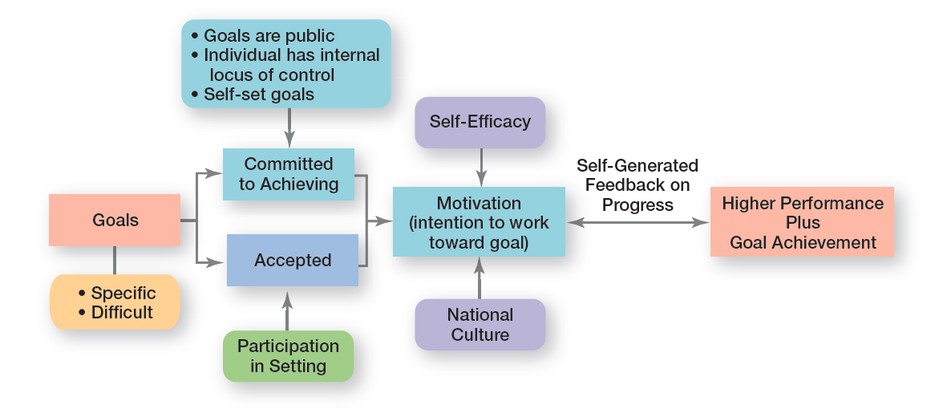
Exhibit 16-5 Goal-Setting Theory
Exhibit 16-5 summarizes the relationships among goals, motivation, and performance
Notes:
Exhibit 16-5 summarizes the relationships among goals, motivation, and performance. One overall conclusion is that the intention to work toward hard and specific goals is a powerful motivating force. Under the proper conditions, it can lead to higher performance. However, no evidence indicates that such goals are associated with increased job satisfaction.

Slide 21
Reinforcement Theory
Reinforcement theory: the theory that behavior is a function of its consequences
Reinforcers: consequences immediately following a behavior, which increase the probability that the behavior will be repeated are called reinforcers.
Reinforcement theory ignores factors such as goals, expectations, and needs.
Instead, it focuses solely on what happens to a person when he or she does something
Notes:
Reinforcement theory says that behavior is a function of its consequences. Those consequences that immediately follow a behavior and increase the probability that the behavior will be repeated are called reinforcers. Reinforcement theory ignores factors such as goals, expectations, and needs. Instead, it focuses solely on what happens to a person when he or she does something.

Slide 22
According to B. F. Skinner, people will most likely engage in desired behaviors if they are rewarded for doing so. These rewards are most efective if they immediately follow a desired behavior; and behavior that isn’t rewarded, or is punished, is less likely to be repeated.
Using reinforcement theory, managers can infuence employees’ behavior by using positive reinforcers for actions that help the organization achieve its goals. And managers should ignore, not punish, undesirable behavior

Slide 23
Designing Motivating Jobs (1 of 2)
If you look closely at what an organization is and how it works, you’ll find that it’s composed of thousands of tasks. These tasks are, in turn, aggregated into jobs.
Job design: the way tasks are combined to form complete jobs
Job scope: the number of different tasks required in a job and the frequency with which those tasks are repeated
Job enlargement: the horizontal expansion of a job by increasing job scope
Notes:
Because managers want to motivate individuals on the job, we need to look at ways to design motivating jobs. We use the term job design to refer to the way tasks are combined to form complete jobs. The jobs people perform in an organization should not evolve by chance. Managers should design jobs deliberately and thoughtfully to reflect the demands of the changing environment; the organization’s technology; and employees’ skills, abilities, and preferences.
An early effort at overcoming the drawbacks of job specialization involved horizontally expanding a job through increasing job scope—the number of different tasks required in a job and the frequency with which these tasks are repeated. For instance, a dental hygienist’s job could be enlarged so that in addition to cleaning teeth, he or she is pulling patients’ files, refiling them when finished, and sanitizing and storing instruments. This type of job design option is called job enlargement.

Slide 24
Designing Motivating Jobs (2 of 2)
Job enrichment: the vertical expansion of a job by adding planning and evaluating responsibilities
Job depth: the degree of control employees have over their work
Job characteristics model (JCM): a framework for analyzing and designing jobs that identifies five primary core job dimensions, their interrelationships, and their impact on outcomes
Notes:
Another approach to job design is the vertical expansion of a job by adding planning and evaluating responsibilities—job enrichment. Job enrichment increases job depth, which is the degree of control employees have over their work. In other words, employees are empowered to assume some of the tasks typically done by their managers. Thus, an enriched job allows workers to do an entire activity with increased freedom, independence, and responsibility.
Even though many organizations implemented job enlargement and job enrichment programs and experienced mixed results, neither
approach provided an effective framework for managers to design motivating jobs. But the job characteristics model (JCM) does. It identifies five core job dimensions, their interrelationships, and their impact on employee productivity, motivation, and satisfaction.

Slide 25
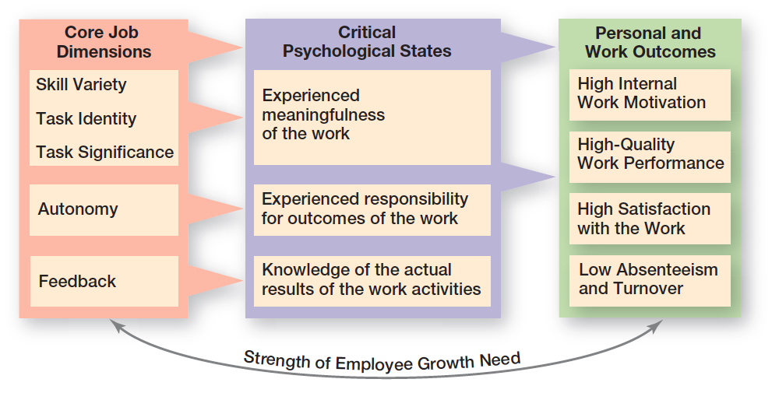
Exhibit 16-6 Job Characteristics Model
Exhibit 16-5 shows the JCM.
Notes:
Source: “Job Characteristics Model,” from Work Redesign, by J. R. Hackman & G. R. Oldham. Copyright © 1980 by Addison- Wesley (a division of Pearson). Reprinted with permission.

Slide 26
Five Core Job Dimensions (1 of 2)
Skill variety: the degree to which a job requires a variety of activities so that an employee can use a number of different skills and talents
Task identity: the degree to which a job requires completion of a whole and identifiable piece of work
Task significance: the degree to which a job has a substantial impact on the lives or work of other people
Notes:
These five core job dimensions are:
1. Skill variety, the degree to which a job requires a variety of activities so that an employee can use a number of different skills and talents.
2. Task identity, the degree to which a job requires completion of a whole and identifiable piece of work.
3. Task significance, the degree to which a job has a substantial impact on the lives or work of other people.

Slide 27
Five Core Job Dimensions (2 of 2)
Autonomy: the degree to which a job provides substantial freedom, independence, and discretion to the individual in scheduling work and determining the procedures to be used in carrying it out
Feedback: the degree to which carrying out work activities required by a job results in the individual’s obtaining direct and clear information about his or her performance effectiveness
Notes:
4. Autonomy, the degree to which a job provides substantial freedom, independence, and discretion to the individual in scheduling the work and determining the procedures to be used in carrying it out.
5. Feedback, the degree to which doing work activities required by a job results in an individual obtaining direct and clear information about the effectiveness of his or her performance.

Slide 28
Redesigning Job Design Approaches (1 of 2)
Relational perspective of work design: an approach to job design that focuses on how people’s tasks and jobs are increasingly based on social relationships
Proactive perspective of work design: an approach to job design in which employees take the initiative to change how their work is performed
Notes:
Two emerging viewpoints on job design are causing a rethink of the JCM and other standard approaches. Let’s take a look at each perspective.
The first perspective, the relational perspective of work design, focuses on how people’s tasks and jobs are increasingly based on social relationships. In jobs today, employees have more interactions and interdependence with coworkers and others both inside and outside the organization. In doing their job, employees rely more and more on those around them for information, advice, and assistance. So what does this mean for designing motivating jobs? It means that managers need to look at important components of those employee relationships such as access to and level of social support in an organization, types of interactions outside an organization, amount of task interdependence, and interpersonal feedback.
The second perspective, the proactive perspective of work design, says that employees are taking the initiative to change how their work is performed. They’re much more involved in decisions and actions that affect their work. Important job design factors according to this perspective include autonomy (which is part of the JCM), amount of ambiguity and accountability, job complexity, level of stressors,
and social or relationship context. Each of these has been shown to influence employee proactive behavior.

Slide 29
Redesigning Job Design Approaches (2 of 2)
High-involvement work practices: work practices designed to elicit greater input or involvement from workers
Notes:
One stream of research that’s relevant to proactive work design is high involvement work practices, which are designed to elicit greater input or involvement from workers. The level of employee proactivity is believed to increase as employees become more involved in decisions that affect their work. Another term for this approach, which we discussed in an earlier chapter, is employee empowerment.

Slide 30
Equity Theory (1 of 2)
Equity theory: The theory that an employee compares his or her job’s input-outcomes ratio with that of relevant others and then corrects any inequity
Notes:
Equity theory, developed by J. Stacey Adams, proposes that employees compare what they get from a job (outcomes) in relation to what they put into it (inputs), and then they compare their inputs–outcomes ratio with the inputs–outcomes ratios of relevant others (Exhibit 16-7). If an employee perceives her ratio to be equitable in comparison to those of relevant others, there’s no problem. However, if the ratio is inequitable, she views herself as underrewarded or overrewarded. When inequities occur, employees attempt to do something about it. The result might be lower or higher productivity, improved or reduced quality of output, increased absenteeism, or voluntary resignation.

Slide 31
Equity Theory (2 of 2)
Referents: the persons, systems, or selves against which individuals compare themselves to assess equity
Distributive justice: perceived fairness of the amount and allocation of rewards among individuals
Procedural justice: perceived fairness of the process used to determine the distribution of rewards
Notes:
The referent—the other persons, systems, or selves individuals compare themselves against in order to assess equity—is an important variable in equity theory.
Originally, equity theory focused on distributive justice, the perceived fairness of the amount and allocation of rewards among individuals. More recent research has focused on looking at issues of procedural justice, the perceived fairness of the process used to determine the distribution of rewards.
Research shows that distributive justice has a greater influence on employee satisfaction than procedural justice, while procedural justice tends to affect an employee’s organizational commitment, trust in his or her boss, and intention to quit.

Slide 32
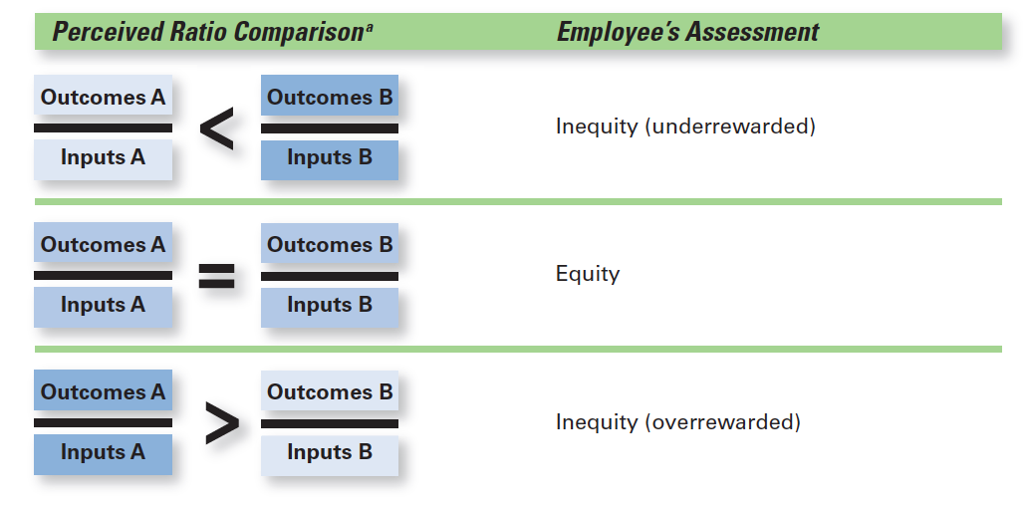
Exhibit 16-7 Equity Theory
Exhibit 16-5 shows the Equity Theory.
Notes:
Source: “Job Characteristics Model,” from Work Redesign, by J. R. Hackman & G. R. Oldham. Copyright © 1980 by Addison- Wesley (a division of Pearson). Reprinted with permission.

Slide 33
Expectancy Theory
Expectancy theory: the theory that an individual tends to act in a certain way based on the expectation that the act will be followed by a given outcome and on the attractiveness of that outcome to the individual
Notes:
The most comprehensive explanation of how employees are motivated is Victor Vroom’s expectancy theory. Expectancy theory states that an individual tends to act in a certain way based on the expectation that the act will be followed by a given outcome and on the attractiveness of that outcome to the individual. It includes three variables or relationships (see Exhibit 16-8).

Slide 34
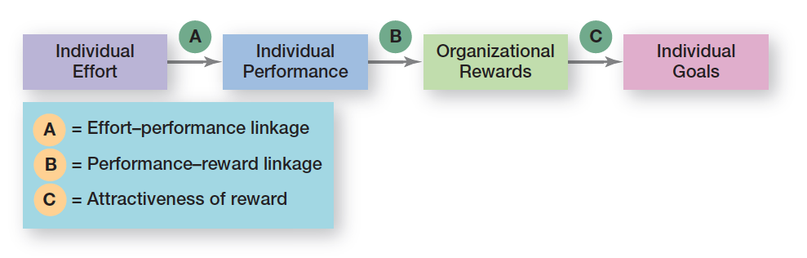
Exhibit 16-8 Expectancy Model
Exhibit 16-8 illustrates the three relationships in the expectancy model.

Slide 35
Expectancy Relationships
Expectancy or effort-performance linkage
Instrumentality or performance-reward linkage
Valence or attractiveness of reward
Notes:
1. Expectancy or effort–performance linkage is the probability perceived by the individual that exerting a given amount of effort will lead to a certain level of performance.
2. Instrumentality or performance–reward linkage is the degree to which the individual believes that performing at a particular level is instrumental in attaining the desired outcome.
3. Valence or attractiveness of reward is the importance an individual places on the potential outcome or reward that can be achieved on the job. Valence considers both the goals and needs of the individual.

Slide 36
Integrating Contemporary Theories of Motivation
Expectancy or effort–performance linkage
Instrumentality or performance–reward linkage
Valence or attractiveness of reward
Notes:
1. Expectancy or effort–performance linkage is the probability perceived by the individual that exerting a given amount of effort will lead to a certain level of performance.
2. Instrumentality or performance–reward linkage is the degree to which the individual believes that performing at a particular level is instrumental in attaining the desired outcome.
3. Valence or attractiveness of reward is the importance an individual places on the potential outcome or reward that can be achieved on the job. Valence considers both the goals and needs of the individual.

Slide 37
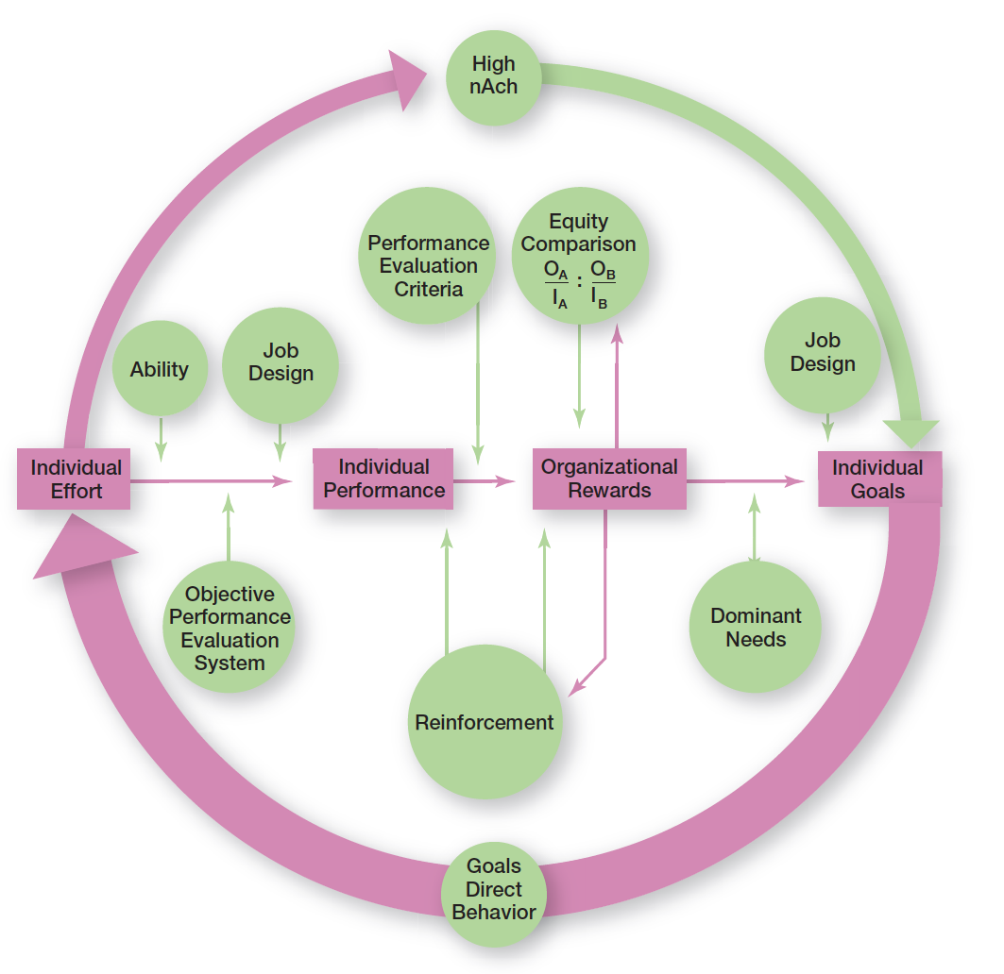
Exhibit 16-9 Integrating Contemporary Theories of Motivation
Exhibit 16-9 presents a model that integrates much of what we know about motivation
Notes:
Many of the ideas underlying the contemporary motivation theories are complementary, and you’ll understand better how to motivate people if you see how the theories fit together. Exhibit 16-9 presents a model that integrates much of what we know about motivation. Its basic foundation is the expectancy model. Let’s work through the model, starting on the left.
The individual effort box has an arrow leading into it. This arrow flows from the individual’s goals. Consistent with goal-setting theory, this goals–effort link is meant to illustrate that goals direct behavior. Expectancy theory predicts that an employee will exert a high level of effort if he or she perceives a strong relationship between effort and performance, performance and rewards, and rewards and satisfaction of personal goals. Each of these relationships is in turn influenced by certain factors. You can see from the model that the level of individual performance is determined not only by the level of individual effort but also by the individual’s ability to perform and by whether the organization has a fair and objective performance evaluation system. The performance–reward relationship will be strong if the individual perceives that performance (rather than seniority, personal favorites, or some other criterion) is what is rewarded. The final link in expectancy theory is the rewards–goal relationship. The traditional need theories come into play at this point. Motivation would be high to the degree that the rewards an individual received for his or her high performance satisfied the dominant needs consistent with his or her individual goals.

Slide 38
Managing Cross-Cultural Motivational Challenges
In today’s global business environment, managers can’t assume motivational programs that work in one location will work in others.
Most current motivation theories were developed in the United States by Americans and about Americans.
Notes:
In today’s global business environment, managers can’t automatically assume motivational programs that work in one geographic location are going to work in others. Most current motivation theories were developed in the United States by Americans and about Americans. Maybe the most blatant pro-American characteristic in these theories is the strong emphasis on individualism and achievement. For instance, both goal-setting and expectancy theories emphasize goal accomplishment as well as rational and individual thought.

Slide 39
Motivating Unique Groups of Workers
Diverse employees
Professionals
Contingent workers
Low-skilled minimum wage employees
Notes:
Employees come into organizations with different needs, personalities, skills, abilities, interests, and aptitudes. They have different expectations of their employers and different views of what they think their employer has a right to expect of them. And they vary widely in what they want from their jobs.

Slide 40
Flexibility
Compressed workweeks
Flextime
Job sharing
Telecommuting
Notes:
To maximize motivation among today’s workforce, managers need to think in terms of flexibility. For instance, studies tell us that men place more importance on having autonomy in their jobs than women. In contrast, the opportunity to learn, convenient and flexible work hours, and good interpersonal relations are more important to women. Many organizations have developed flexible work arrangements—such as compressed workweeks, flextime, and job sharing that recognize different needs.

Slide 41
Motivating Professionals
Job challenge
Finding solutions to problems
Support
Perception that their work is important
Notes:
What motivates professionals? Money and promotions typically are low on their priority list. Why? They tend to be well paid and enjoy what they do. In contrast, job challenge tends to be ranked high. They like to tackle problems and find solutions. Their chief reward is the work itself. Professionals also value support. They want others to think that what they are working on is important. That may be true for all employees, but professionals tend to be focused on their work as their central life interest, whereas nonprofessionals typically have other interests outside of work that can compensate for needs not met on the job.

Slide 42
Motivating Contingent Workers
Opportunity to become a permanent employee
Opportunity for training
Equity in compensation and benefits
Notes:
What will motivate involuntarily temporary employees? An obvious answer is the opportunity to become a permanent employee. In cases in which permanent employees are selected from a pool of temps, the temps will often work hard in hopes of becoming permanent. A less obvious answer is the opportunity for training. The ability of a temporary employee to find a new job is largely dependent on his or her skills.

Slide 43
Motivating Low-Skilled, Minimum Wage Employees
Employee recognition programs
Provision of sincere praise
Notes:
In motivating minimum-wage employees, managers might look at employee recognition programs. Many managers also recognize the power of praise although these “pats on the back” must be sincere and given for the right reasons.

Slide 44
Designing Appropriate Rewards Programs
Open-book management: a motivational approach in which an organization’s nancial statements (the “books”) are shared with all employees
Employee recognition programs: personal attention and expressing interest, approval, and appreciation for a job well done
Pay-for-performance programs: variable compensation plans that pay employees on the basis of some performance measure
Notes:
Many organizations of various sizes involve their employees in workplace decisions by opening up the financial statements (the “books”). They share that information so employees will be motivated to make better decisions about their work and better able to understand the implications of what they do, how they do it, and the ultimate impact on the bottom line. This approach is called openbook management and many organizations are using it.
Employee recognition programs consist of personal attention and expressing interest, approval, and appreciation for a job well done. They can take numerous forms.
Pay-for-performance programs are variable compensation plans that pay employees on the basis of some performance measure. Piece-rate pay plans, wage incentive plans, profit-sharing, and lump-sum bonuses are examples. What differentiates these forms of pay from more traditional compensation plans is that instead of paying a person for time on the job, pay is adjusted to reflect some performance measure.

Slide 45
Review Learning Objective 16.1
Define motivation.
1. Identify problem
2. Identify decision criteria
3. Weight the criteria
Notes:
Motivation is the process by which a person’s efforts are energized, directed, and sustained toward attaining a goal.
The energy element is a measure of intensity, drive, or vigor. The high level of effort needs to be directed in ways that help the organization achieve its goals. Employees must persist in putting forth effort to achieve those goals.

Slide 46
Review Learning Objective 16.2
Compare and contrast early theories of motivation.
Maslow’s hierarchy of needs
Theory X/Theory Y
Herzberg’s theory
Three-needs theory
Notes:
In Maslow’s hierarchy, individuals move up the hierarchy of five needs (physiological, safety, social, esteem, and self-actualization) as needs are substantially satisfied. A need that’s substantially satisfied no longer motivates.
A Theory X manager believes people don’t like to work or won’t seek out responsibility so they have to be threatened and coerced to work. A Theory Y manager assumes people like to work and seek out responsibility, so they will exercise self-motivation and self-direction.
Herzberg’s theory proposed that intrinsic factors associated with job satisfaction were what motivated people. Extrinsic factors associated with job dissatisfaction simply kept people from being dissatisfied. Three-needs theory proposed three acquired needs that are major motives in work: need for achievement, need for affiliation, and need for power.

Slide 47
Review Learning Objective 16.3
Compare and contrast contemporary theories of motivation.
Goal-setting theory
Reinforcement theory
Job enlargement/enrichment/characteristics model
Equity theory
Expectancy theory
Notes:
Goal-setting theory says that specific goals increase performance, and difficult goals, when accepted, result in higher performance than easy goals. Important points in goal-setting theory include intention to work toward a goal as a major source of job motivation; specific hard goals that produce higher levels of output than generalized goals; participation in setting goals as preferable to assigning goals, but not always; feedback that guides and motivates behavior, especially self-generated feedback; and contingencies that affect goal-setting—goal commitment, self-efficacy, and national culture.
Reinforcement theory says that behavior is a function of its consequences. To motivate, use positive reinforcers to reinforce desirable behaviors. Ignore undesirable behavior rather than punishing it.
Job enlargement involves horizontally expanding job scope by adding more tasks or increasing how many times the tasks are done.
Job enrichment vertically expands job depth by giving employees more control over their work.
The job characteristics model says five core job dimensions (skill variety, task identity, task significance, autonomy, and feedback) are used to design motivating jobs. Another job design approach proposed looking at relational aspects and proactive aspects of jobs.
Equity theory focuses on how employees compare their inputs–outcomes ratios to relevant others’ ratios. A perception of inequity will cause an employee to do something about it. Procedural justice has a greater influence on employee satisfaction than distributive justice. Expectancy theory says an individual tends to act in a certain way based on the expectation that the act will be followed by a desired outcome. Expectancy is the effort–performance linkage (how much effort do I need to exert to achieve a certain level of performance?); instrumentality is the performance–reward linkage (achieving at a certain level of performance will get me a specific reward); and valence is the attractiveness of the reward (is it the reward that I want?).

Slide 48
Review Learning Objective 16.4
Discuss current issues in motivation.
Managing cross-cultural challenges
Motivating unique groups of workers
Designing appropriate rewards programs
Notes:
Managers must cope with three current motivation issues: managing cross-cultural challenges, motivating unique groups of workers, and designing appropriate rewards programs.
Most motivational theories were developed in the United States and have a North American bias. Some theories (Maslow’s need hierarchy, achievement need, and equity theory) don’t work well for other cultures. However, the desire for interesting work seems important to all workers and Herzberg’s motivator (intrinsic) factors may be universal.
Managers face challenges in motivating unique groups of workers. A diverse workforce is looking for flexibility. Professionals want job challenge and support and are motivated by the work itself. Contingent workers want the opportunity to become permanent or to receive skills training. Recognition programs and sincere appreciation for work done can be used to motivate low-skilled, minimum-wage workers.
Open-book management is when financial statements (the books) are shared with employees who have been taught what they mean. Employee recognition programs consist of personal attention, approval, and appreciation for a job well done. Pay-for-performance programs are variable compensation plans that pay employees on the basis of some performance measure.

Slide 49

Copyright

